Slide 1

Amazon Product Sales 2023
THARUN KUMAR VARDHINENI
BHARGAV ATTI
ROHITH MECHINENI

Slide 2

Audience

Slide 3
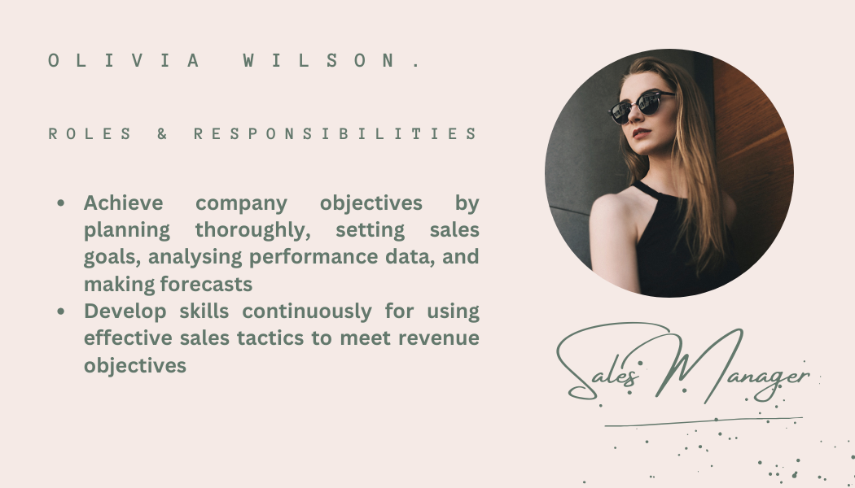

Slide 4


Slide 5


Slide 6


Slide 7

Main Goal
Total product Sales and quality analysis of a product by customer satisfaction
How people are preferring their wants compared to needs

Slide 8
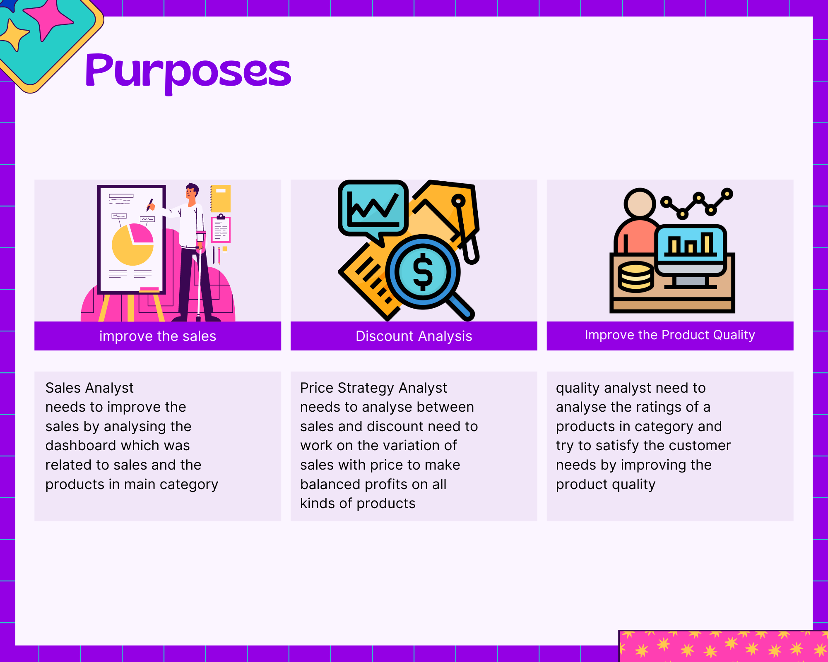
Story Board

Slide 9
Objectives
Comparing the Sales of each category to know the highest and least sales.
Categorize needs Vs wants and analyze the sales where people are spending their money in.
Discount Analysis on category to compare the sales
Average Rating analysis should be done to estimate the product quality by customer satisfaction

Slide 10
Kpi’s & variable indicators
KPI
Rating
No of ratings
Discount Percentage
Variable Indicators
Name
Type
Main Category
Sub Category

Slide 11

Chart & Table requirements
The line graph depicts the information about sales with respect to main category which was ordered from highest to least.
The stacked bar chart shows the analysis between needs and wants of a basic people.
The stacked row chart illustrates the comparison of sales and discount in % to help in making decision over sales of respective category.
The heatmap represents the rating of respective category to conclude product quality.

Slide 12
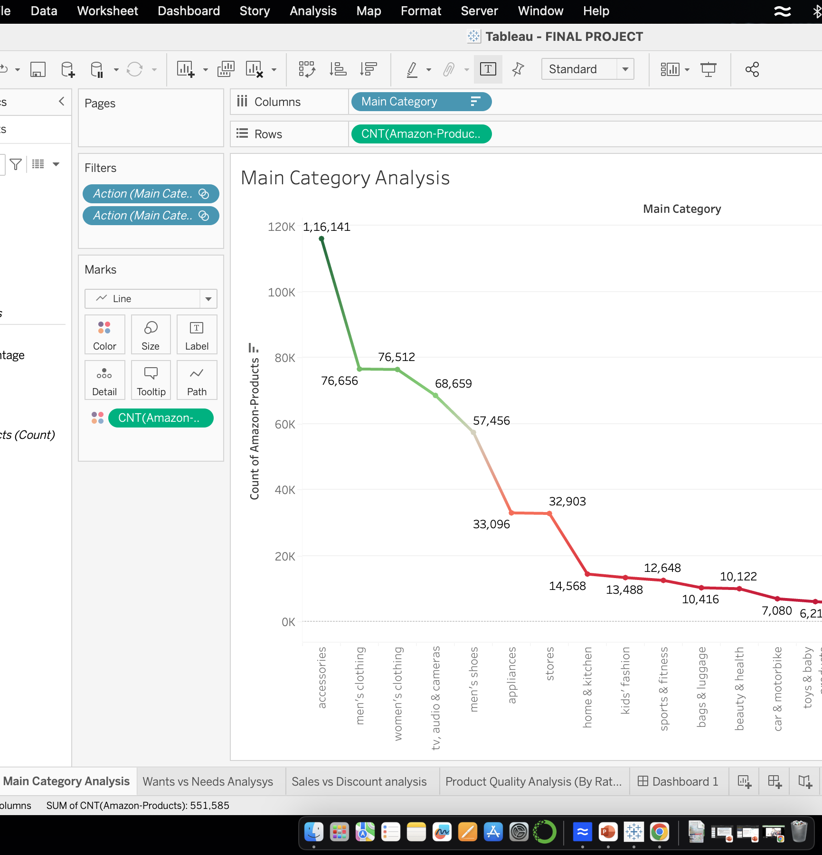
Chart-1 Displaying the Sales with respect to category
In this we have shown the data as a tabular chart to display the sales of each category
By this we can conclude the highest and least sales of a category in 2023
Through this one can know for which category of products they can improve their marketing or promotions to make them sold better.

Slide 13
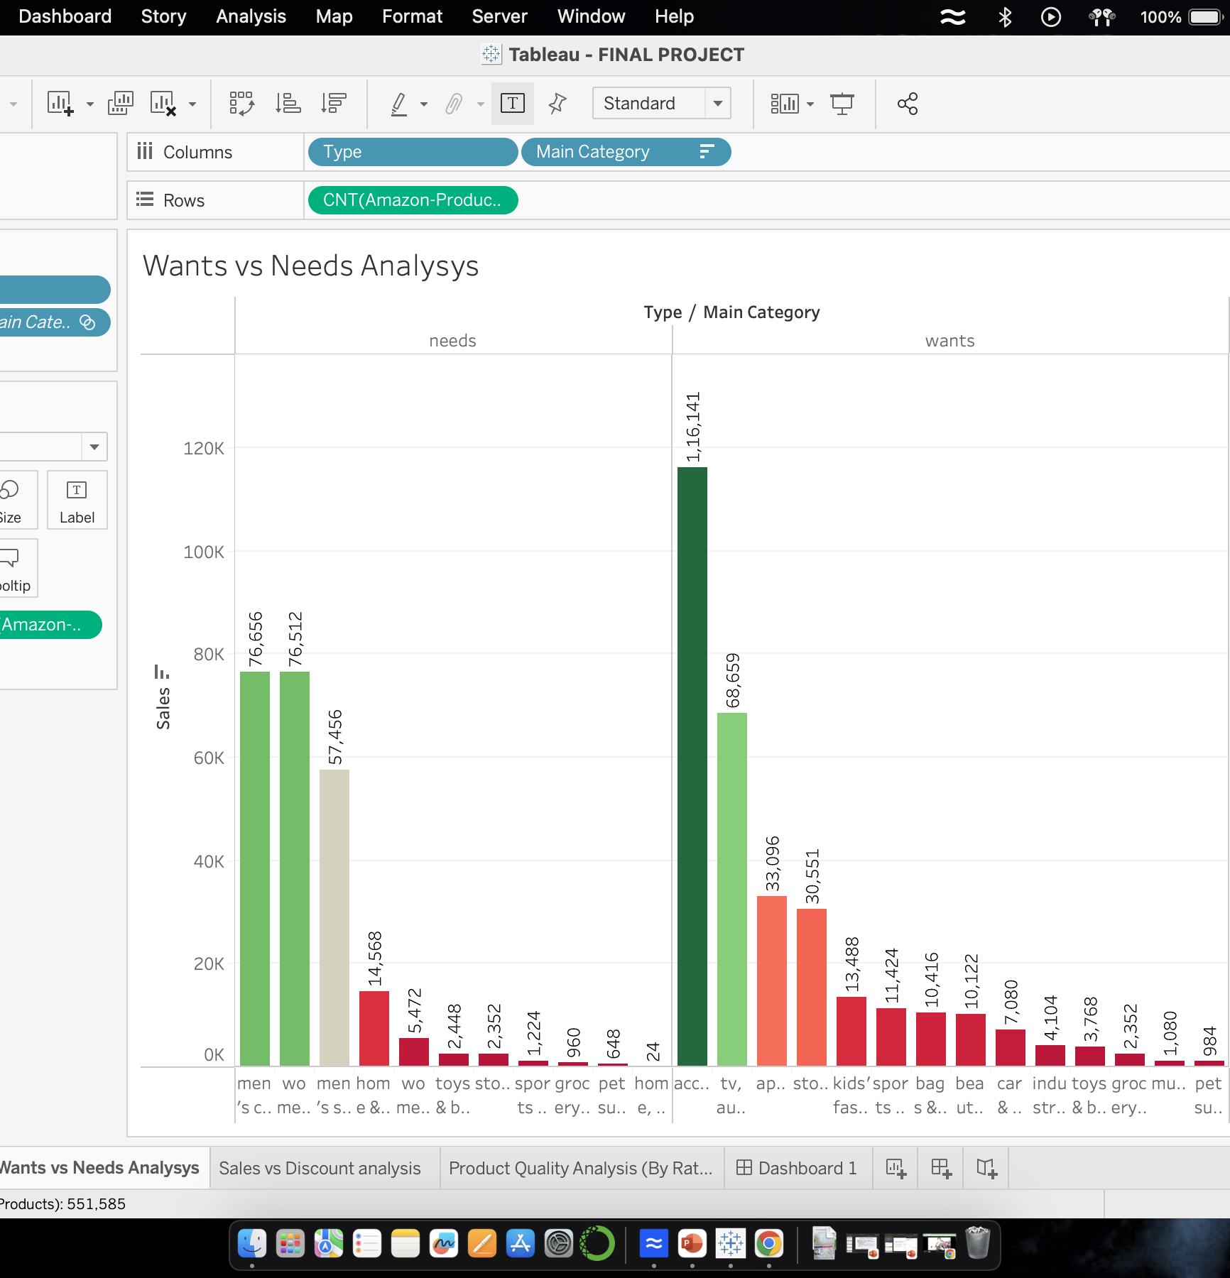
Chart-2 Categorizing needs Vs Wants
In this we are categorizing sales and wants based on basic human necessities.
In this we represented a stacked column chart which was categorized between needs and wants with respect to main category
By analysis amazon sold a lot number in wants when compared to needs
In Detail accessories are the most sold category in amazon & clothing is the main category which was most sold when comparing to needs.

Slide 14
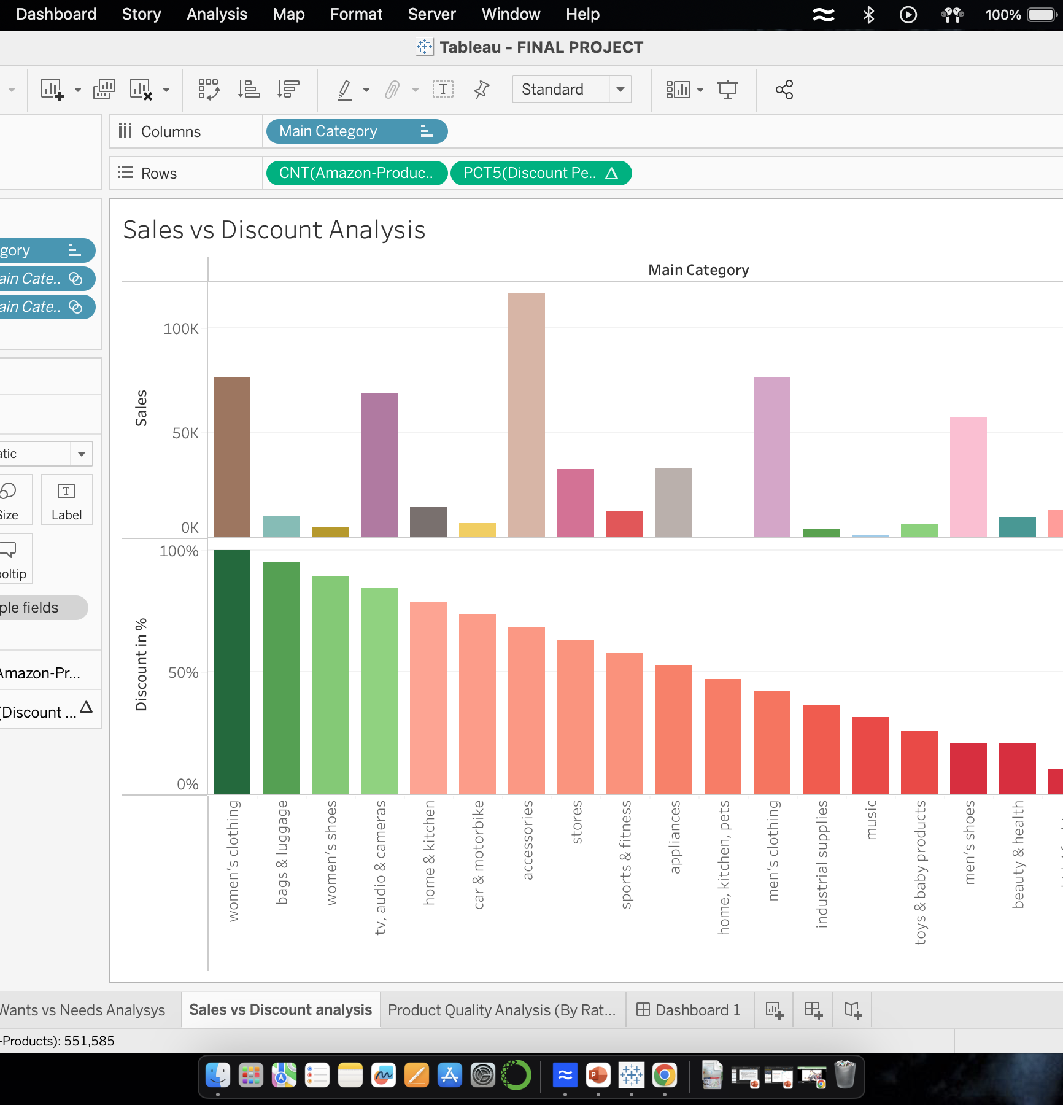
Chart-3 Sales Vs Discount Analysis
In this stacked row chart we represented both discount and sales analysis of a main categories.
By this we have a thought of connecting discount and sales one can conclude where to adjust discount to the respective category efficiently to improve the sales

Slide 15
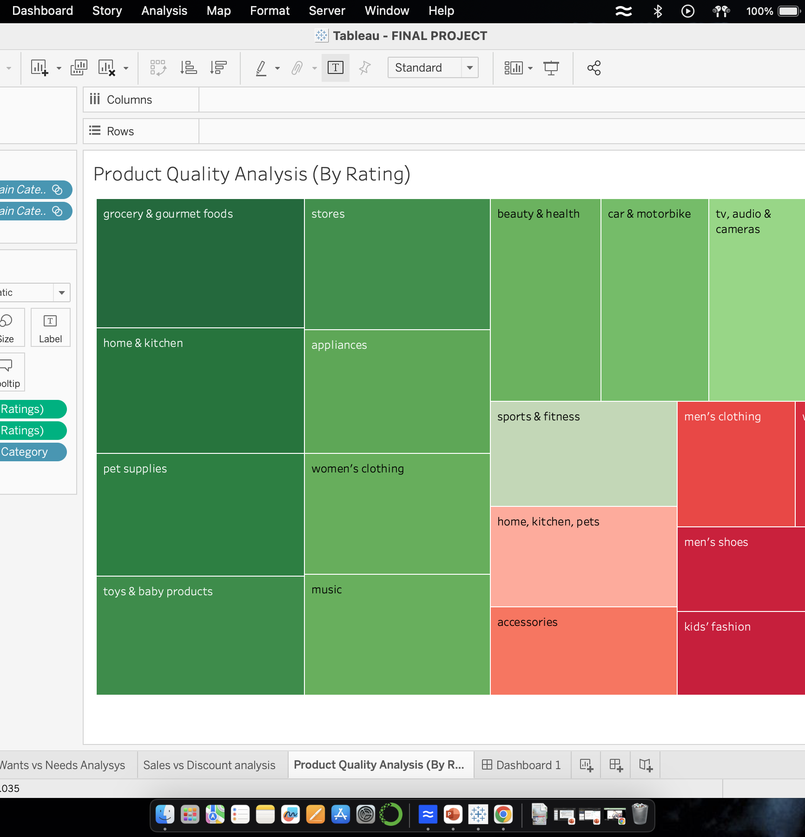
Chart-4 Customer Rating Analysis
In this heat map we are representing the average rating of particular products in a category to know the customer satisfaction on quality of a product.
Actual product reviews are helpful in improving the product quality and its sales.
This heat map varies color from red to green with respect to ratings from low to high.

Slide 16
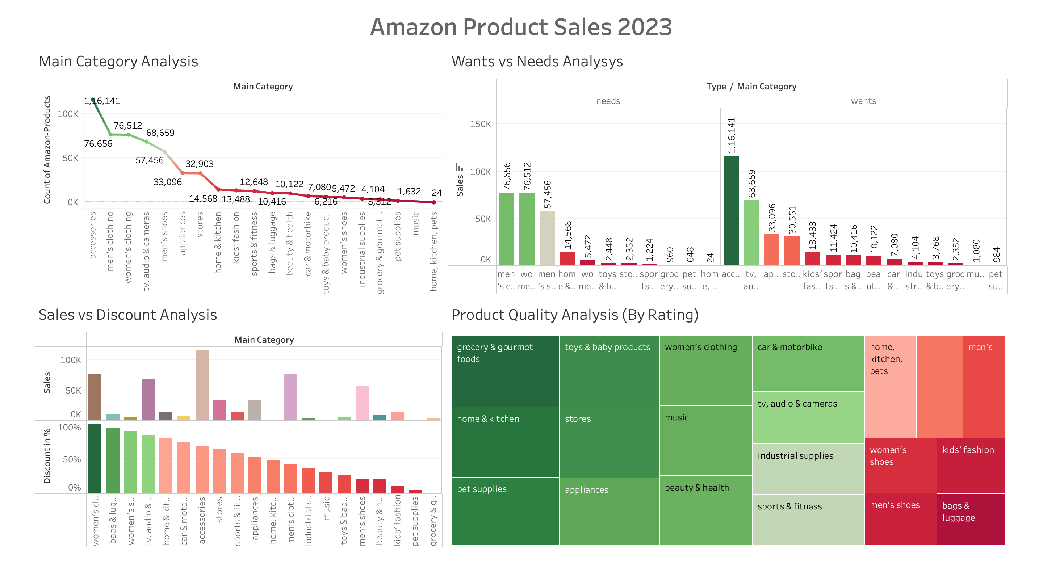

Slide 17

Thankyou

